Slide 1
Kairos Advisory Council
The Journey to
Excelling in your Role

Slide 2
Introductions
Jay Perrien
Rick Wilminko
Notes:
Jay:
My name is Jeriana Perrien but everyone calls me Jay.
I was introduced to Kairos Prison Ministry through my husband Michael who had been incarcerated in Florida. He was blessed to have attended a Kairos Inside weekend. He wanted me to go to a Kairos Outside Weekend, but I wouldn’t because I only had 2 weekends a month to visit and I wanted to see him. When he came home after settling in, he reached out to a Kairos Inside Leader in Southwest Florida and found out who was leading the next weekend for Kairos Outside, got her number called her and handed me the phone “You need to talk to Her.” In April of 2011 I attended weekend # 7 of Kairos Outside Southwest Florida and have been involved ever since. In 2015 we moved back to Ohio and I was able to be on the Kairos Outside Northeast Ohio #2 weekend. And here I am today. Continuing to be blessed by this Ministry and Thankful that God is still not done with me yet.
Rick
Adlib

Slide 3
Devotion and Prayer
Enjoy the Journey
“Make a joyful noise to the Lord, all you lands! Serve the Lord with gladness!
Come before His presence with singing!”
-Psalm 100:1-2
Notes:
Rick – Devotional
So many Christians are headed somewhere, but not many of us are enjoying the trip. It would be such a tragedy to arrive at the end of your journey only to realize you had not enjoyed life to its fullest. Often, you think you must do something great, and you forget the simple things that bless the Lord. Serving the Lord with gladness is a worthy goal. He rejoices when your heart is filled with joy and your mouth is filled with praise.
You should be determined to finish your course. But like Paul, you should strive to run the race with joy. Whatever your present station in life, whatever you are called to do, wherever you are called to go, enjoy the journey. Don’t waste one day of the precious life God has given you. Rejoice in the Lord, and again I say, rejoice!
As Jesus came down from heaven, He taught each of us how to be a joyful servant. Let each Advisory Council realize their responsibility to Promote the health & wellness of God’s Ministry and Kairos Prison Ministry. The Advisory Council is a servant to Christ and the Mission of Kairos Prison Ministry: Our journey is sharing the transforming love and forgiveness of Jesus Christ to Impact the hearts and lives of incarcerated men, women, and youth, as well as their families to become loving and productive citizens of the communities. Let’s all join the Journey to serve.
Jay – Prayer
Prayer: Father, we come to you in Awe of who you are, our creator and sustainer, our Strength and Peace. Father, we humbly ask for your guidance through you Holy Spirit to Speak the words you would have us speak here today. We thank you for Kairos Prison Ministry International which you have given 50 yrs of prosperity. We thank you that you have given each volunteer involved a heart to support the men, women, youth and families through the challenge of incarceration. We thank you for the volunteers which you have brought to the ministry to present your Love, Grace and Mercy to those incarcerated and their families. We ask that your guiding hand be on each person to bring forth the mission of Kairos Prison Ministry which is to share the transforming love and forgiveness of Jesus Christ, to impact the hearts and lives of the incarcerated men, women and youth as well as their families.

Slide 4
Synergy
Diversity
What makes an Excellent Advisory Council?
Receptive
Goals
Joyful
Teamwork
Trust
Faithfulness
Reliability
Consistency
Collaboration
Empowered
Comply
Humble
Service
Empathy
Tolerant
Oneness
Cohesion
Inclusive
Communicate
Resilience
Focus
Dependability
Accountability
Peaceful
Aligned
Supportive
Adaptability
Aligned
Kindness
Respectful
Notes:
Using only a single work – Describe what makes an EXCELLENT Advisory Council. <advance> Here’s a few that we found.
Does your Advisory Council excel in these or are there any that could use improvement
Let’s talk about a few of these Characteristics.
RESPECTFUL: The definition is honoring the inherent dignity of others and revering God. Each member of the Advisory Council is just as important as the other. We must be respectful of each other. We accomplish nothing if we are not Cohesive, Collaborative, Humble, Inclusive and aligned with the Kairos vision and mission.
FAITHFULNESS: Is the quality of being loyal, steadfast, and trustworthy in upholding commitments, promises and relationships. It involves remaining dedicated and dependable even in the face of changing circumstances or challenges.
COLABORATION: Is the process of two or more individuals or organizations working together to achieve a shared goal: Which for Kairos is to share the transforming love and forgiveness of Jesus Christ, to impact the hearts and lives of the incarcerated men, women and youth as well as their families, to become loving and productive citizens of their communities

Slide 5

Overview of the Journey
What is Excellence
Spiritual Leadership
Program Compliance
Continuous Improvement
Reporting
Stewardship
Integrity
Recruitment and Volunteers
Fundraising
Operational Effectiveness
Notes:
Jay :
Here are the topics we will cover in this session:
Spiritual Leadership
Program Compliance
Continuous improvement
Reporting
Stewardship
Integrity
Recruitment and Volunteers
Fundraising
Operational Effectiveness

Slide 6

What is Excellence?
Commitment
Continuous Improvement
Consistency
Accountability
Spiritual Integrity
Adherence
Notes:
Jay :
We have already identified many characteristic of and Excellent Advisory Council, The Journey of Advisory Council's is to function with excellence.
That does not mean that we are perfect but rather that we are on a Journey to excellence through commitment, continuous improvement and consistency.
The Kairos Advisory Council functions with an elevated level of accountability, spiritual integrity and strict adherence to the Advisory Council Operating Procedures and Kairos Program Manual.
As we go through each point you may be able to see how your council is on their own Journey to excellence.

Slide 7

Spiritual Leadership
Christ Centered
Biblically Focused
Servant Leadership
Notes:
Rick
An Advisory Council for Kairos Prison Ministry International functions at its best when it acts as a lay-led, Christ-centered, and disciplined team that implements ministry programs with a spirit of excellence and spiritual integrity at the local community level.

Slide 8

Christ Centered and Biblically Focused
Begin meetings with devotion and prayer
Pray about goals and needs
Bring conflicts to the Lord
Notes:
Biblical Focus - Every meeting includes prayer and devotions, ensuring the ministry remains spiritually grounded, God-honoring, and focused.
Pray about the needs from your community, your teams, for individuals, and for the program
Prayer needs to over all conflicts and is resolution
Is your Advisory Council praying about the needs of your community, like finances and volunteers?
The Spiritual aspects of your Advisory Council are one of the three most imports to keep in focus. We’ll tale about the other two later in the session

Slide 9
Servant Leadership
Together
Servant Leadership
Everyone
Achieves
T
E
A
M
Listen, Listen, Love, Love
Lay lead
More
Notes:
Servant Leadership - Leaders function as “Lay Lead” "servant leaders" rather than CEOs, modeling Christ's love through the practice of "Listen, Listen, Love, Love".
Remember that TEAM is an acrostic for Togher Everyone Achieves More. REMEMBER, there’s no “I” in team.
Jay: As an Advisory Council member, no position is greater than the other. Every position is essential for a Kairos Prison Ministry to function, grow and prosper. Remember, no matter what your position “It’s All Ministry”

Slide 10
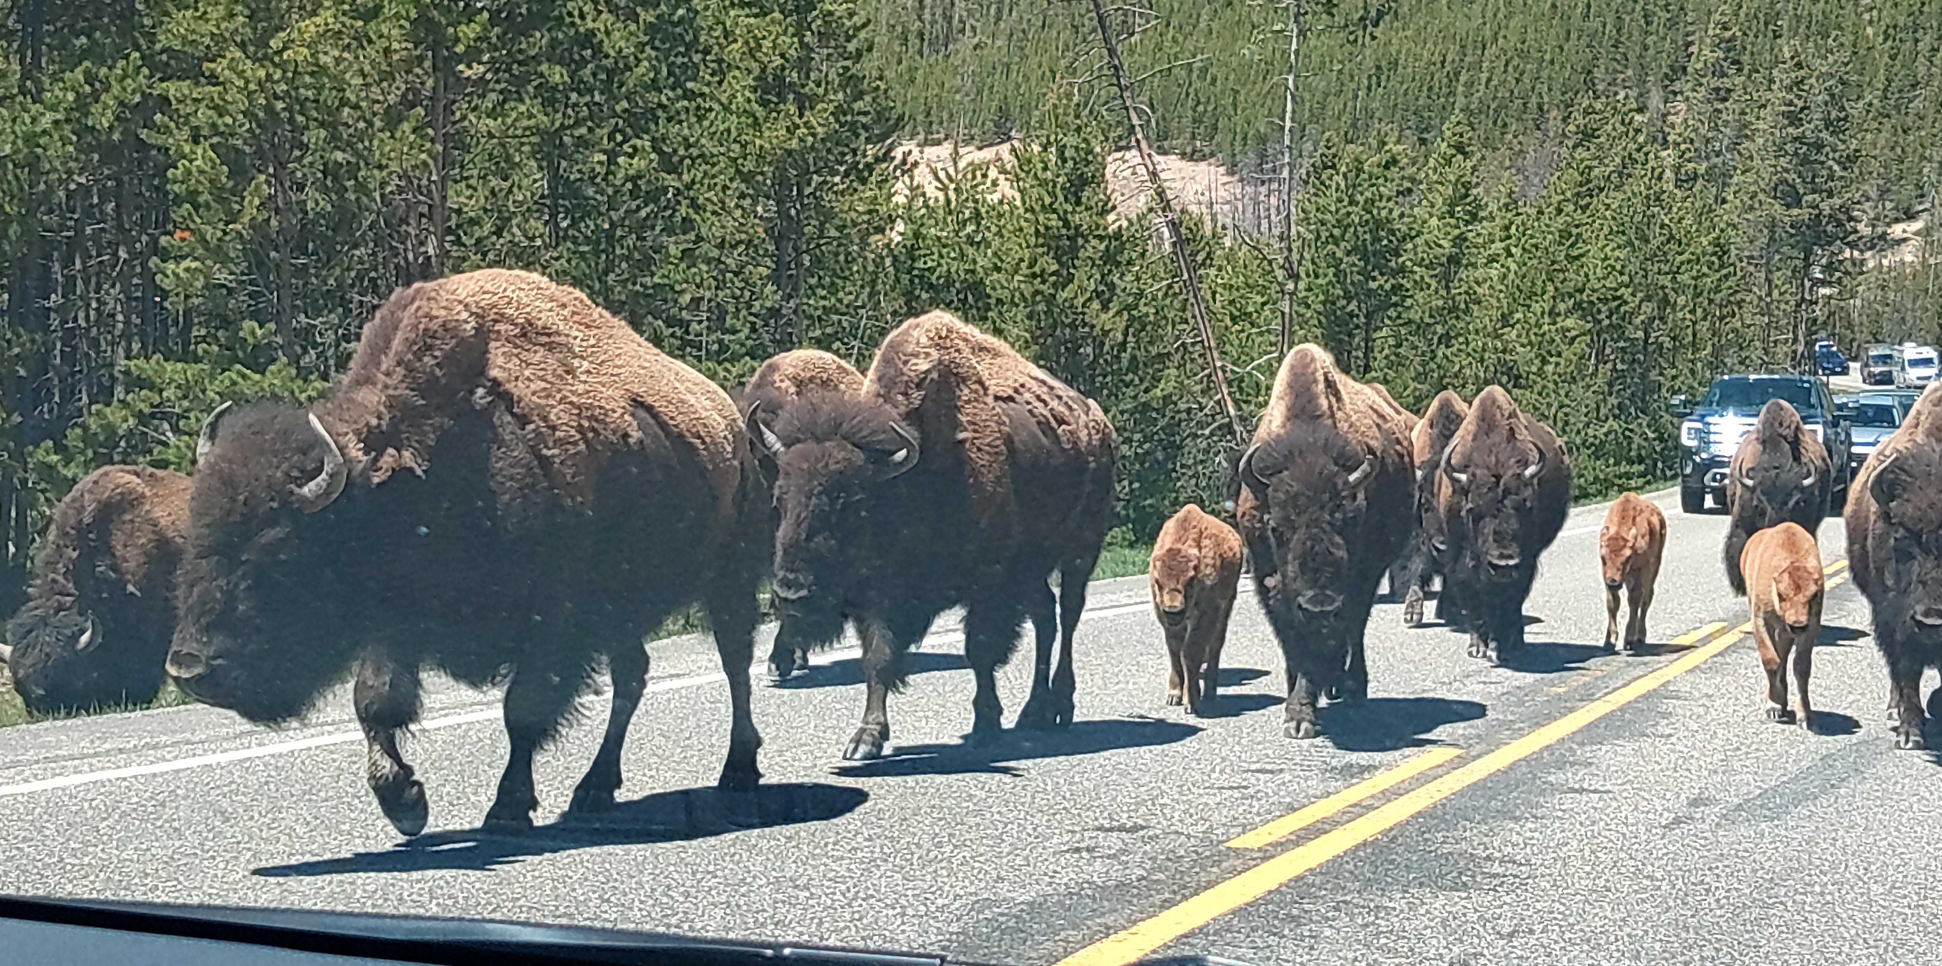
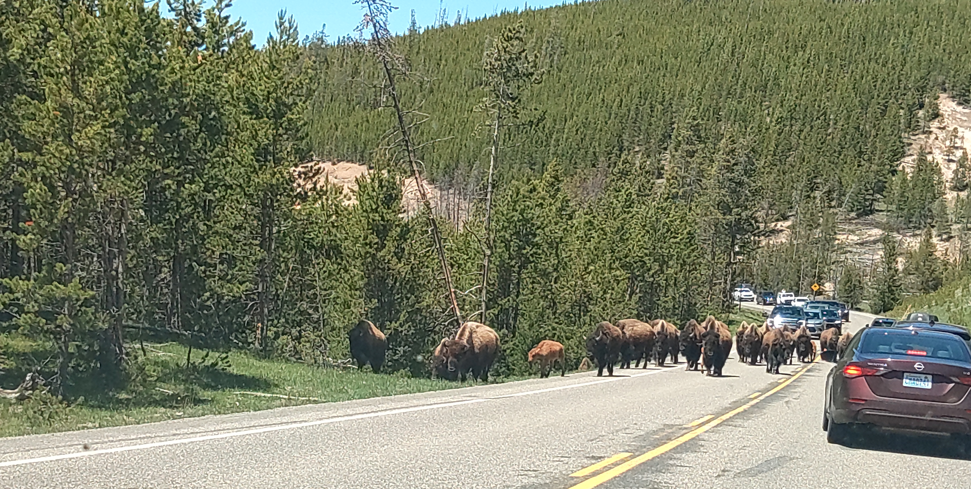
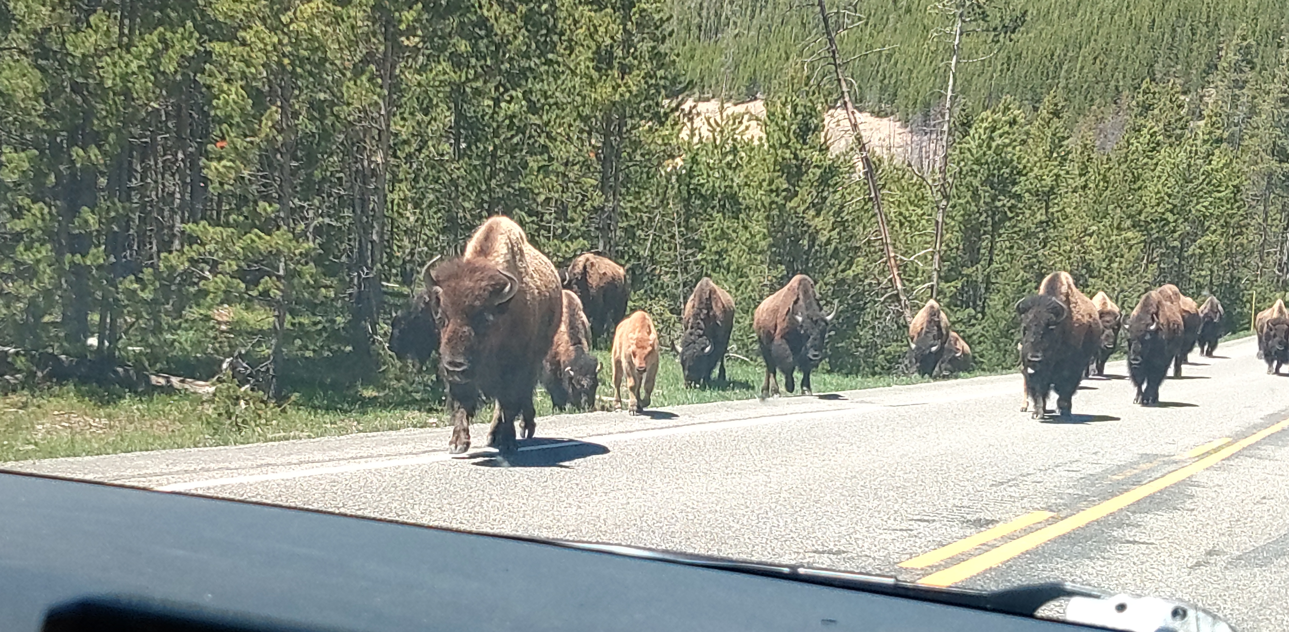
Observing a Team During My Journey in Yellowstone
Notes:
Rick
Explain my time in Yellowstone, God’s beauty in His creations, and how the Bisons demonstrated leadership and teamwork

Slide 11

Program Compliance Tools
Advisory Council Operating Procedures
State Chapter Committee Operating Procedures
Code of Conduct
Kairos Policies and Procedures
Program Manuals for the three programs
Reporting and Evaluations
Training
Annual Affiliation Agreement
Notes:
Jay:
Each Advisory Council is the compliance officers on the Journey to Excellence. It is the responsibility of Kairos Advisory Council to ensure consistency and compliance to the policies & procedures developed by Kairos Prison Ministry.
The Advisory Council Operating procedures as well as The program specific manuals which are the “Gold Standard” of excellence ensuring every weekend and Continuing Ministry event follow the time-tested “Widom of Kairos”. Ensuring that each event stays with in the “Riverbanks” to safeguard Kairos Prison Ministry, our teams, and the resident and guests we serve.
Every Advisory Council needs to be familiar with ALL these tools.
<Recording> If you are not, please find them in either mykairos.org or your program manual
<Live> How many of you are NOT familiar with ALL of these? <If not hands> Good! <If hand go up> Okay, If you have questions about them, we can cover those at the end of the session.

Slide 12
Continuous Improvement
Advisory Council Training
Advanced Kairos Training
KairosMessenger Training
Continuing Ministry Training
KairosDonor Training
Institution Liaison Training
MyKairos.org
Implement and Train
Execute
Report
Evaluate
Improve
Pray
Plan
Design
Build
Meetings
Weekends
Recruitment
Fund Raising
Continuing Ministry
?
Pray
What can be Improved?
What is going well?
Ask the team
Excellence Initiative
Weekend Leader Report
KairosDonor
KairosMessenger
Ask the team
Notes:
Rick
What are you attempting to improve? It could be anything, recruitment, fund raising, Weekends. I would recommend you start with whatever is your pain point or urgent need.
Whare to start– Start with prioritizing Advisory Council Training and Advanced Kairos Training to equip members with the tools needed to perform their duties to the highest standards. But look at the other trainings that are available; KairosMessenger, Continuing Ministry, KairosDonor, Institutional Liaison. Yu can also train your team on MyKairos.org, or some of the procedures
Execute – This means, do the stuff you are supposed to do
Report- Use the Excellence Initiative evaluation tool, not as a "report card," but to objectively measure progress and identify opportunities for training and improvement. Strive for continued improvement.
Honest Evaluation - Instead of avoiding difficult conversations, an excellent Council honestly reviews Weekend Leader reports and Excellence Initiative feedback to address shortfalls before the next program. They also tell you what you’re doing right and should keep doing
Improve – Once you have identified those things you need to change, Pray, Plan, Design, Build and then CHANGE THEM! That’s the Implementation phase where you start all over again

Slide 13

Financial Reporting and Stewardship
Reporting
Stewardship
Notes:
Jay and Rick
Financial Reporting and Stewardship: As an Advisory Council you are responsible to review and update your weekend budgets Annually with your Donor Coordinator & Treasure. Following the Kairos Prison Ministry Financial Policies & Procedures. You are also responsible to make sure your upcoming leaders are aware of what their budget is, as well as how the reporting occurs.
Stewardship: Remembering that Kairos Prison Ministry is fully funded through DONATION. That EVERYTHING IS GOD’s, which he has provided for us to do his ministry through Kairos Prison Ministry International, so we need to be mindful of how we use GOD’s provision.

Slide 14

Integrity
Accountability
Conduct
Notes:
Accountability: Each member of Advisory Council is accountable to the Advisory Council, the State Advisory Council, Kairos Prison Ministry International as well as each resident/guest we serve.
Each Advisory Council need to commit to attending the Advisory Council meeting. Be Consistent through the meetings and program staying within the Riverbanks also applies to Advisory Council Operating Procedures, as well as each members Role on Advisory Council.
Conduct: Each member of Advisory Council needs to act under the Code of Conduct and the Advisory Council Operating Procedure as related to our personal conduct at any Kairos Event. Remembering to Listen, Listen, Love, Love. Being respectful and encouraging each other.

Slide 15

Recruitment and Volunteers
Recruitment
Rotations
Leveraging Strengths
Succession Planning / Replacement Planning
Notes:
Rick and Jay
Without Volunteers there is no Kairos, and without recruitment there are no volunteers. Along with Prayer and Fundraising, Recruiting is one of the Advisory Councils three most impartment objectives.
Recruitment - Advisory Councils must have a Recruitment Plan: Recruitment is a lot like Prayer; it’s a vital part of the Advisory Council’s responsibility and your community. Benjamin Franklin said, “Fail to plan, plan to fail.,” and this really holds true for recruiting.
Volunteers
Donors
Sponsors and Sustaining Donors
Rotations - Actively recruit, train, and support all volunteers to ensure a healthy rotation, remember 3 on 1 off.
The "3-on/1-off" process within Kairos Prison Ministry International is a structured rhythm designed to ensure the sustainability of the ministry and prevent volunteer burnout. It dictates that volunteers participate in three consecutive weekend services or ministry activities (such as a role within the Advisory Council) (the "on" phase) followed by one interval of rest (the "off" phase).
Additionally, during 1-offs, each member should be recruiting and engaging with new volunteers. 1-offs also ensures that individuals are not “owning” the program or a role (e.g., continually doing the same talk, etc.)
Leveraging Strengths - Members are assigned roles that align with their specific spiritual gifts, strengths, and professional talents.
Succession Planning or Replacement Planning –
Replacement plans should identify 1-3 people for each critical position who could step into the position in an emergency and include an indication of each person's readiness to assume the role. <provide examples>
Succession planning is aimed at ensuring the continuous development of talent within the organization so that when a need arises or vacancy occurs, the organization can pull from the existing talent. <provide examples>

Slide 16

Fundraising
Essential to Your Program
It’s Continuous
Allows Other to Participate
All Volunteers Fundraise
Think out of the box
Notes:
Rick –
As you are all aware, without funds, there is no Kairos. With Prayer and Recruitment, Fundraising is one of the three most important parts of you Advisory Councils objectives.
Fundraising should take place year around. Not just before a Weekend. Keep in mind that during your One-Off this can be one of those activities, along with recruiting that you are doing.
For those that don’t wish to volunteer, providing funds is a great way for them to participate. Ask > Volunteer? > Pray? > Donate?
Keep in mind that Volunteer are NOT to pay fees, but ARE expected to Fundraise
Think Out of the Box when thinking of how to Fundraise. Can anyone tell the room of anything they have used that’s out of the box?
Last, we don’t do raffles or any type of Gambling. If you have things to sell, e.g., bake sale, yard sale, anything that you are trying to sell, it’s all for a donation not an asking price.

Slide 17

Continuing Ministry
The Journey to the Growth, Health, & Unity of your Advisory Council, Guests, & Volunteers.
Notes:
Jay:
Advisory Council is responsible to ensure that Continuing Ministry is Occurring. This is a vital component to the ongoing Health, growth and unity of the Kairos Prison Ministry as a whole. Each program has specific guidelines which the advisory council must ensure is occurring. Prayer & Share, Reunion, SWAP what every they are called they are necessary to the ministry. They also must be documented in Ezra.

Slide 18

Operational Effectiveness
Institution Relationships
Effective Meetings
Unity and Servant Leadership
Elections
Mentoring
Notes:
Rick
Institution and Facility Relationships – Create and maintain a positive, line of communication with the facility or institution to ensure security and program approvals are in place. When working with an institution or facility, a top-tier Advisory Council builds trust with leadership, administrators, and staff by following all safety protocols and respecting rules. The best relationships, ensure the best outcomes.
Effective Meetings - Using Roberts Rules, the Advisory Council holds regular, well-organized meetings that foster open dialogue, interactive talking, and proactive problem-solving with all volunteers. Remember, open each meeting with a devotional and prayer.
Unity and Servant Leadership - Working in unity as a local community to serve with humility rather than exercising individual power

Slide 19
Conclusion
Notes:
At its best, the Advisory Council serves as a vital bridge between Kairos international, state leadership, and the local volunteers serving in the ministry.
Always keep it in mind that an Advisory Councils three primary objectives are Prayer, Recruitment, and Fundraising.
Jay: Advisory Council is a living & breathing unit with changes every year. Thus, the Journey Continues, Rely on Prayer, God’s direction, The Council of your Kairos Prison Ministry International Advisor for your program, your State Advisory Council counterpart, as well as your individual members. Continue to use your Continuing Improvement Strategies, Remember WE ARE BETTER TOGETHER.

Slide 20

Questions & Answers

